Slide 1
NDACC Lidar measurements at OHP
S. Godin-Beekmann
NDACC France coordinator
G. Ancellet, P. Keckhut, A. Hauchecorne, S. Khaykin
Lidar PIs

Slide 2
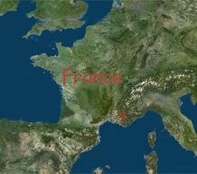
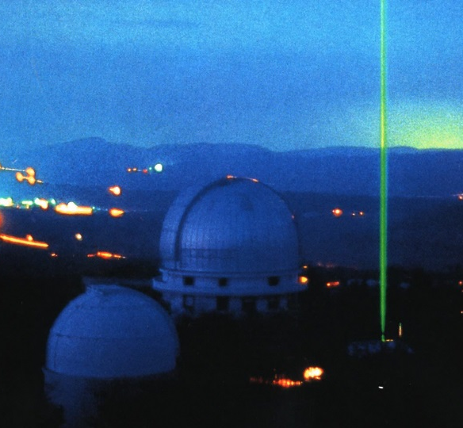
Outline
Status of the instruments
Some science results except from recent aerosol results (S. Khaykin presentation)
Main issues for lidar operations at OHP
OHP

Slide 3
Temperature - H₂O lidar
PIs: A. Hauchecorne, P. Keckhut
Temperature
Time series start in 1979
July 2017 and March 2018 : NDACC LAVANDE intercomparison campaign with the mobile lidar of NASA-GSFC
Since February 2017 : operation in semi automatic mode (manual start, automatic stop). Complete automatic mode foreseen for 2018
Processing of the data at French AERIS data center
Rotational Raman channels (PhD thesis of Yann Caraty) pour temperature measurements in the 0 – 30 km range
Next delivery of data in May 2018.
H2O
Degraded operation of the lidar due to aging filters in the N2 and H2O Raman channels
New filters funded in 2018 and nominal operation foreseen in June 2018

Slide 4
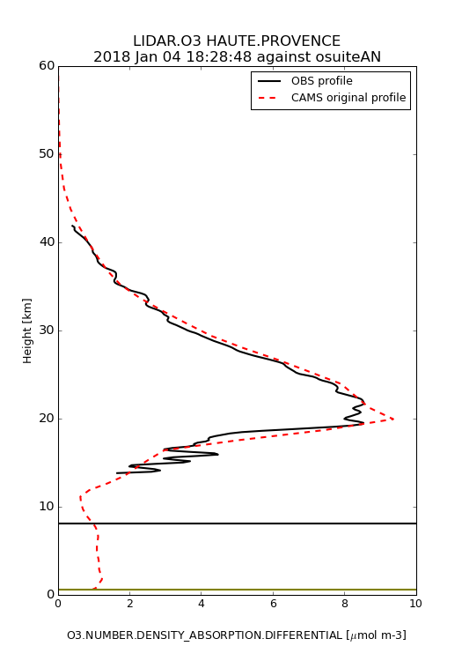
Stratospheric and tropospheric ozone DIALs
PIs: G. Ancellet (tropo) and S. Godin-Beekmann (strato)
Stratospheric O3
Time series starts in 1985
Nominal operation up to April 2018: Nd-Yag breakdown Operation should be resumed at the end of May 2018
Contribution to Copernicus Atmosphere Monitoring service
Collaboration with B. Sica’s team for OEM processing of ozone profile (G. Farhani) – Poster presentation at EGU 2018 and paper near ready for submission
Semi-automatic operation mode ready
Tropospheric O3
Time series starts in 1991
Nominal operation
Needs a new more stable laser for semi-automatic mode

Slide 5
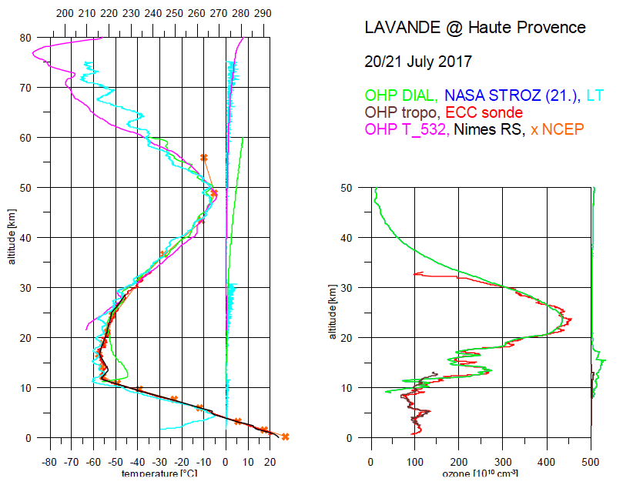
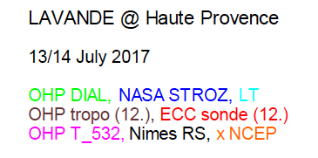
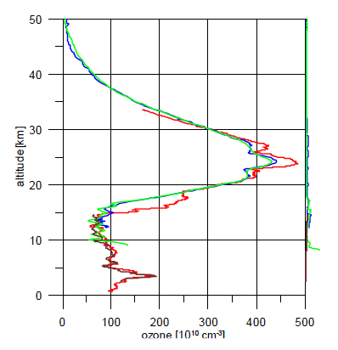
LAVANDE Campaign OHP 2017 - 2018
Intercomparison NDACC campaign NASA (GSFC) mobile lidar
NASA excimer laser breakdown -> :2 periods July 2017 et March 2018
Preliminary results
Referee: W. Steinbrecht (DWD)
NDACC Lidar Working Group Huntsville May 2018

Slide 6
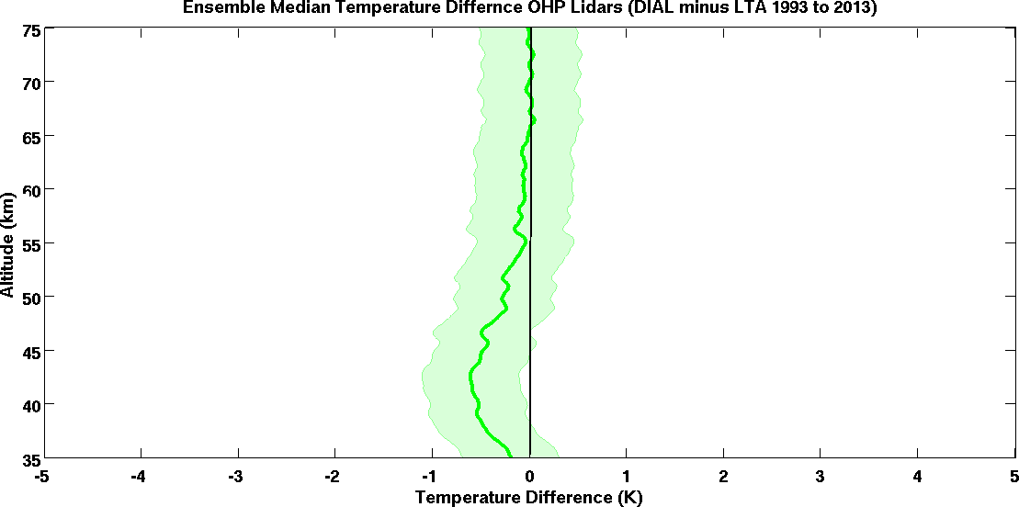
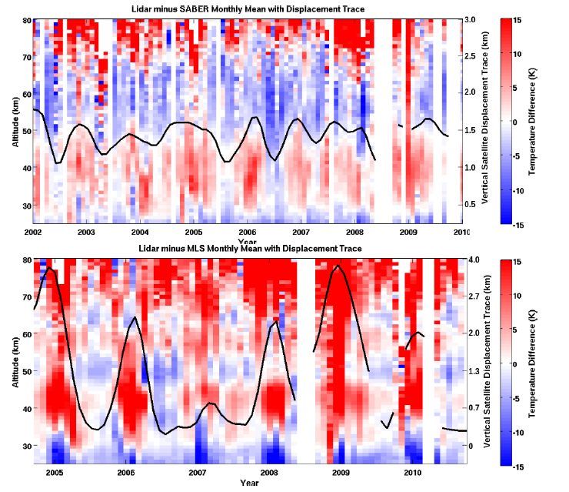
Temperature profiles from LTA and LiO3S OHP lidars
Temperature lidar @532 nm et 355 nm LIO3s channel Unique comparison of 20 years of data
Median discrepancy over 20 years
Lidar O3 strato – lidar T
Difference < 0.6 K from 30 to 75 km
Wing et al., 2018a, submitted
Comparison with SABER et MLS temperature measurements after satellite altitude adjustment
Wing et al., 2018b, submitted

Slide 7
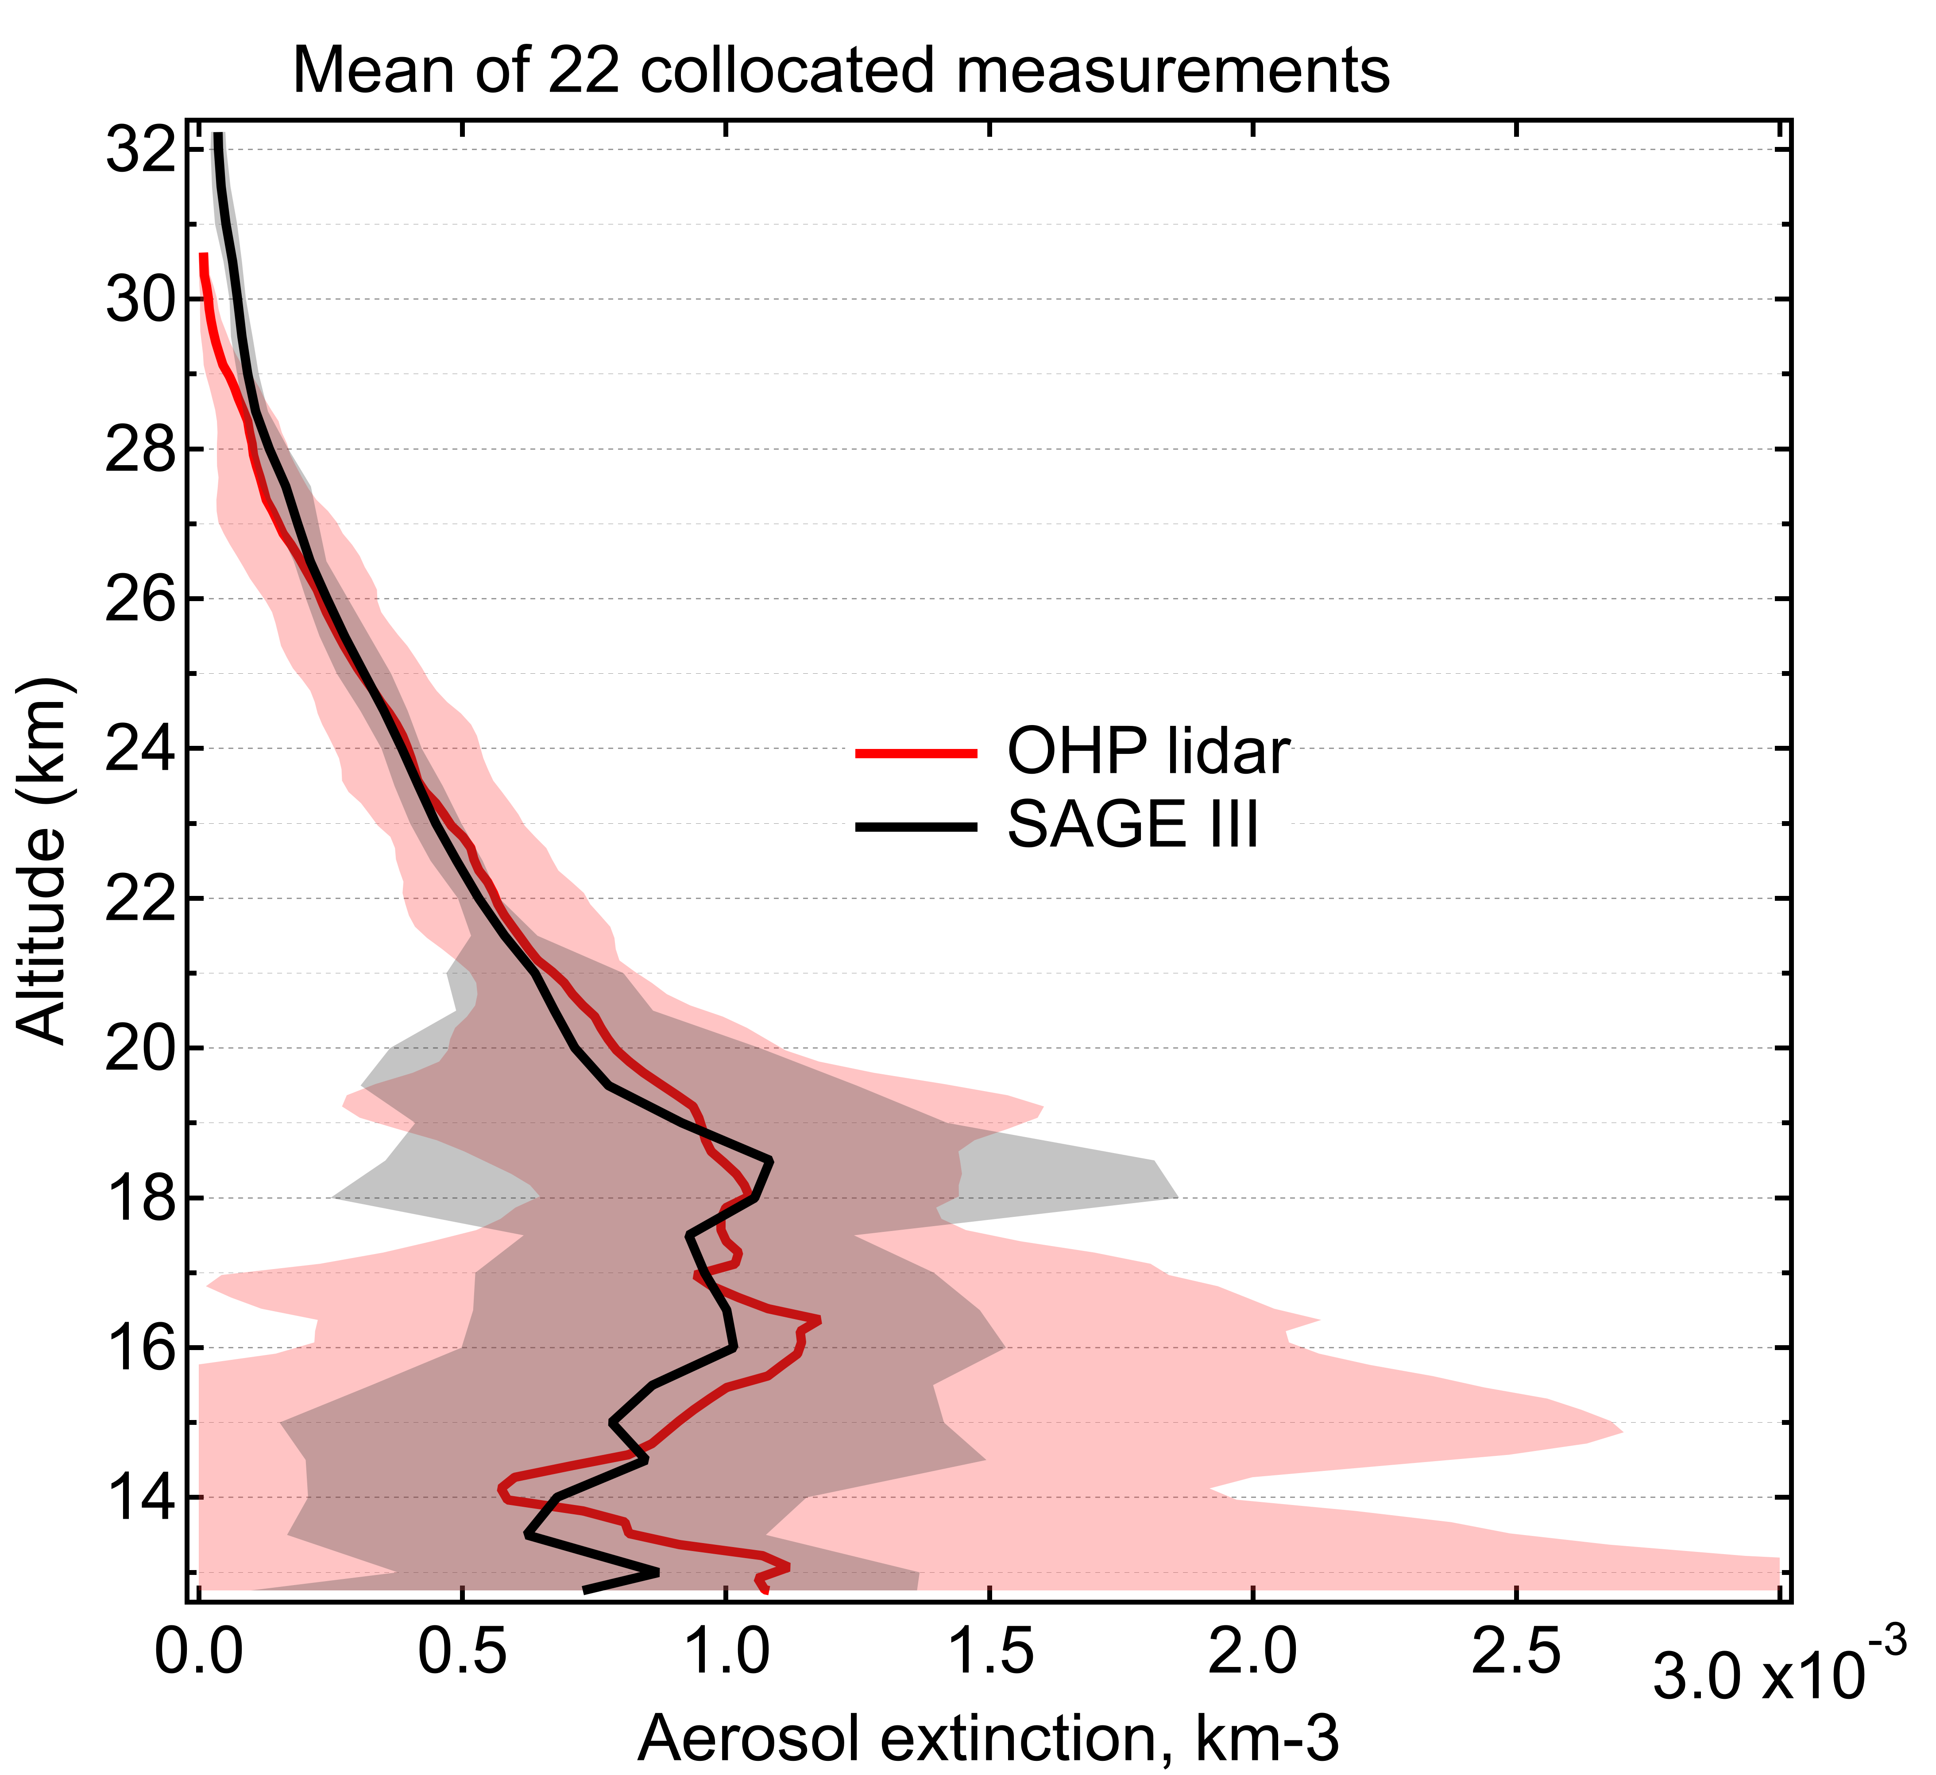
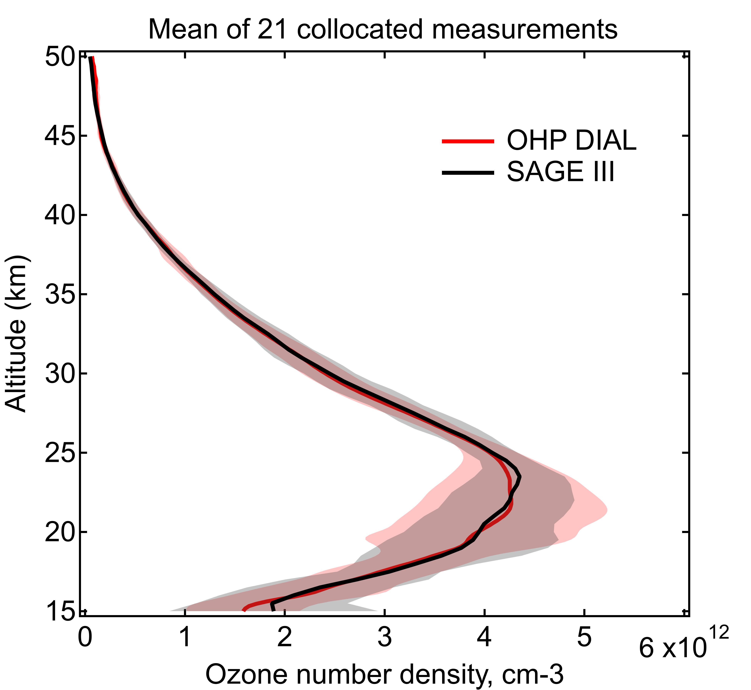
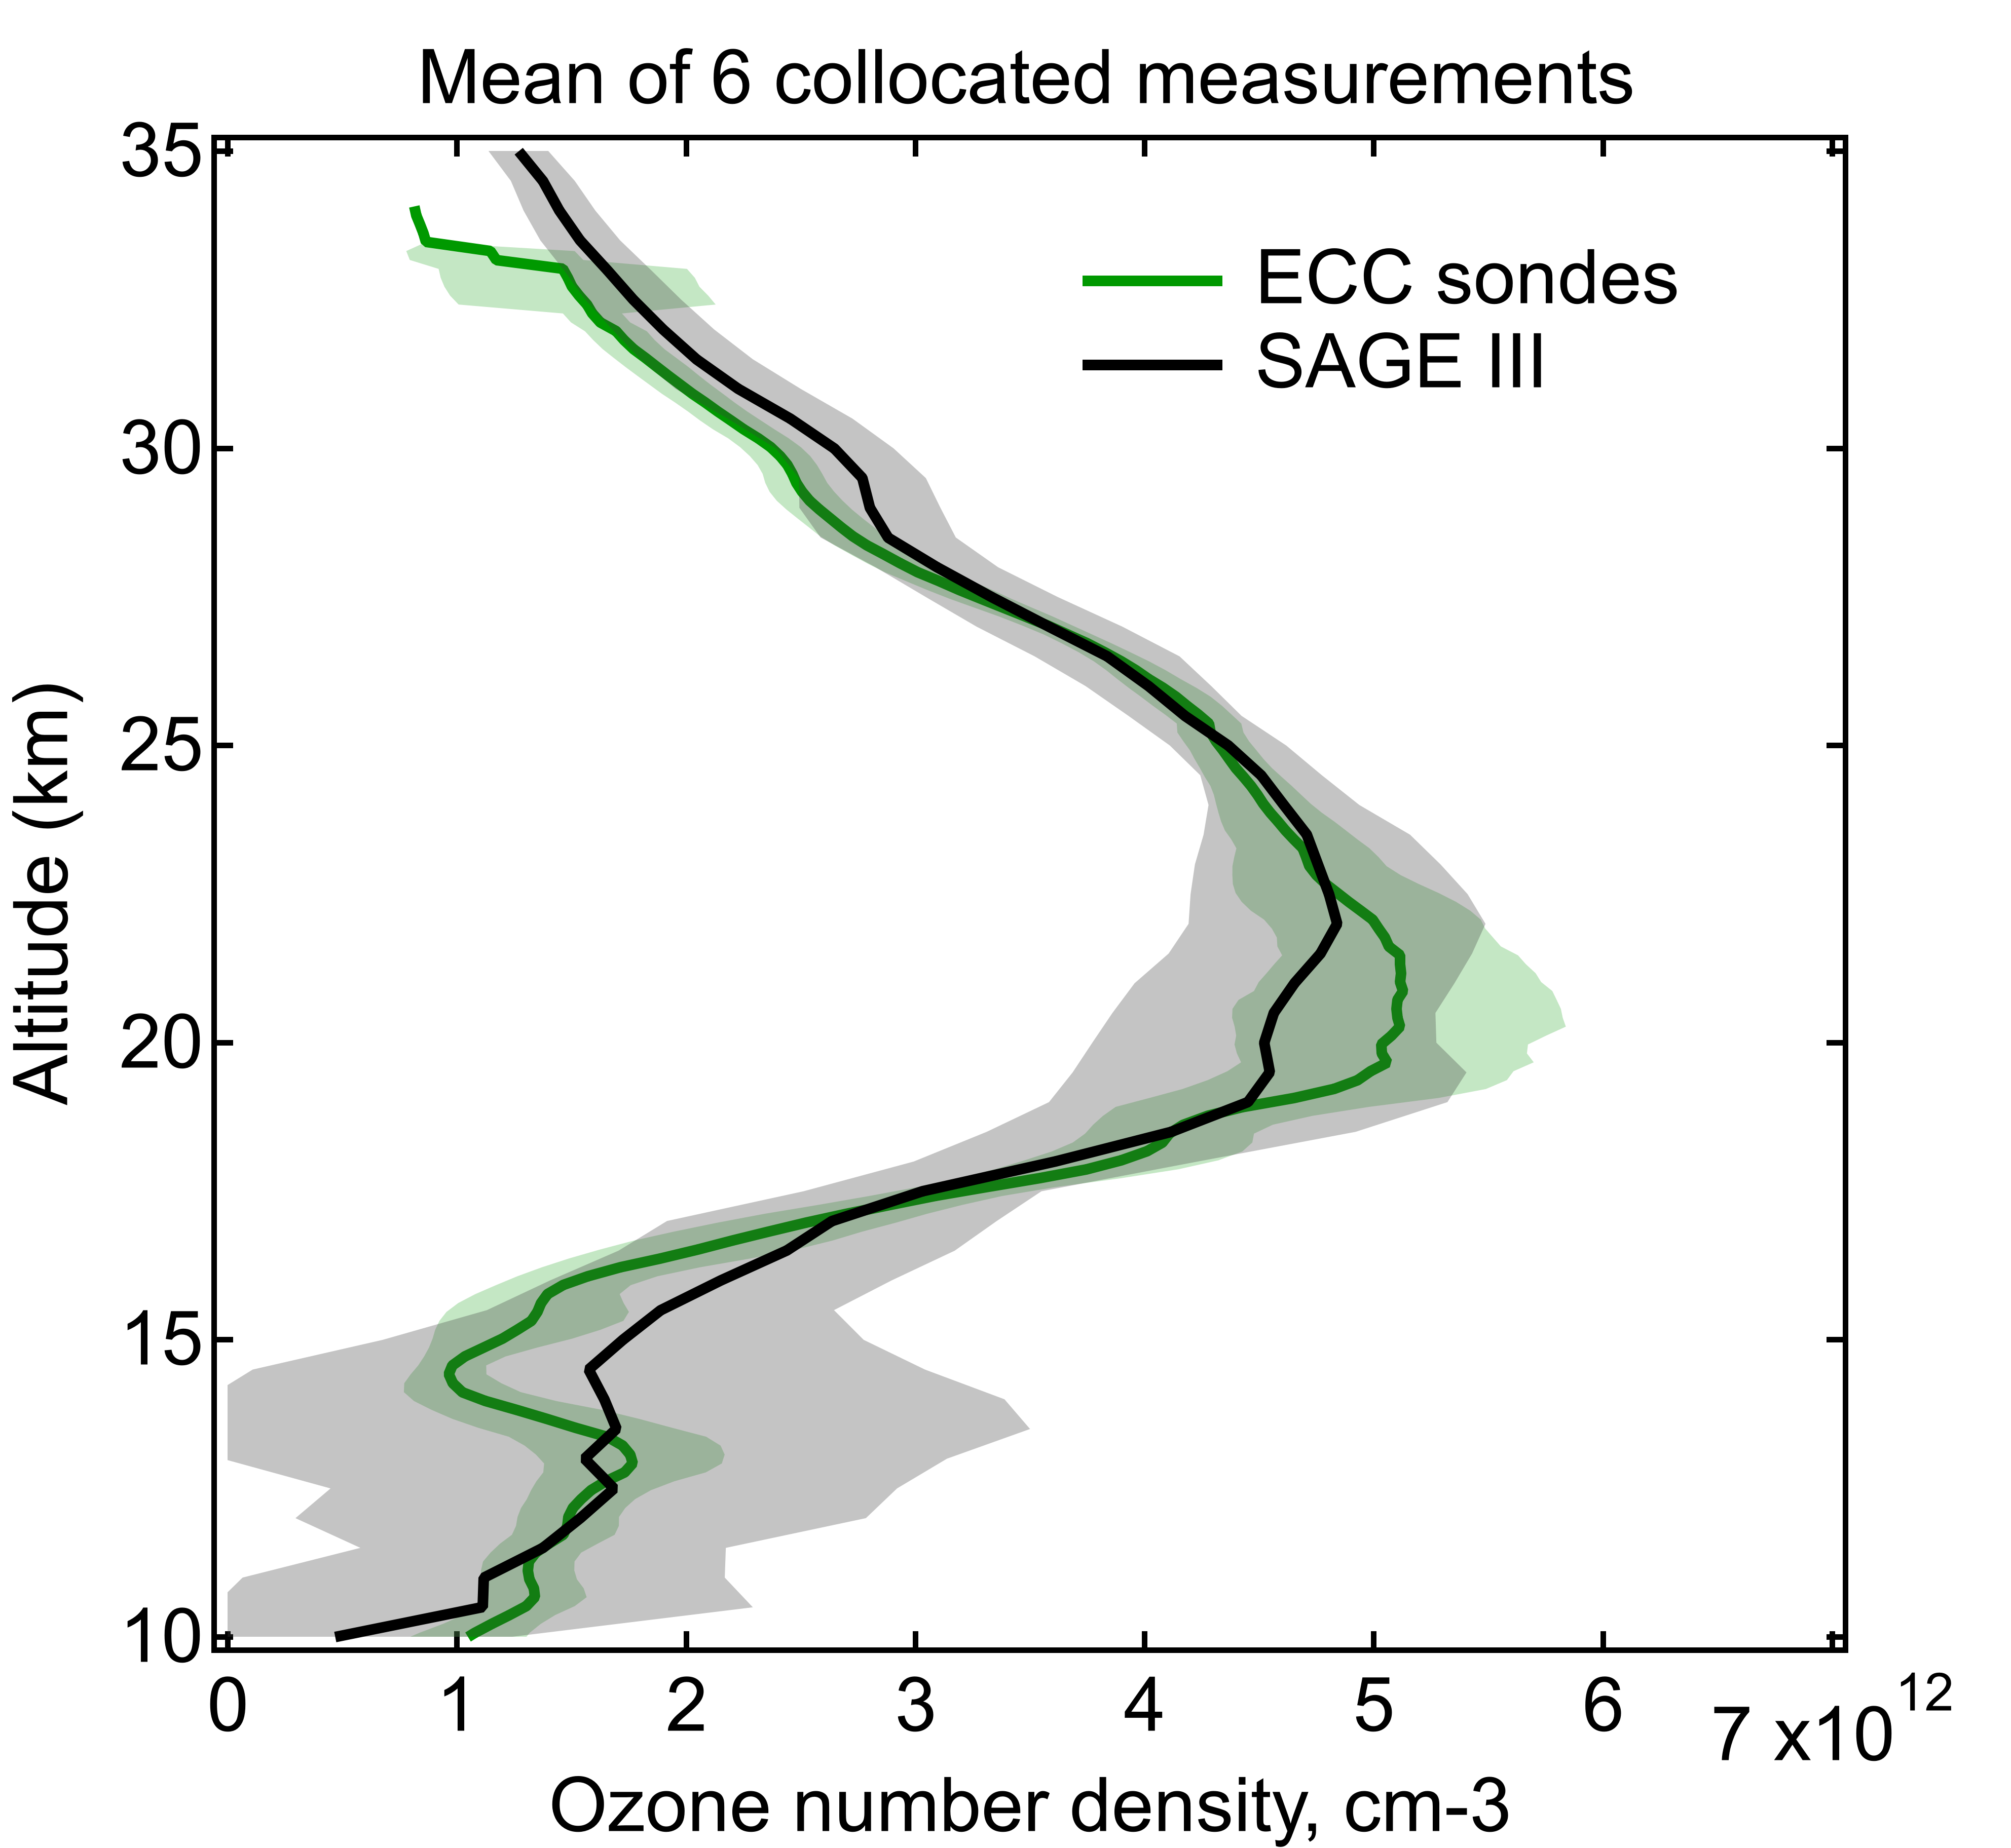
Validation of SAGE III/ISS

Slide 8
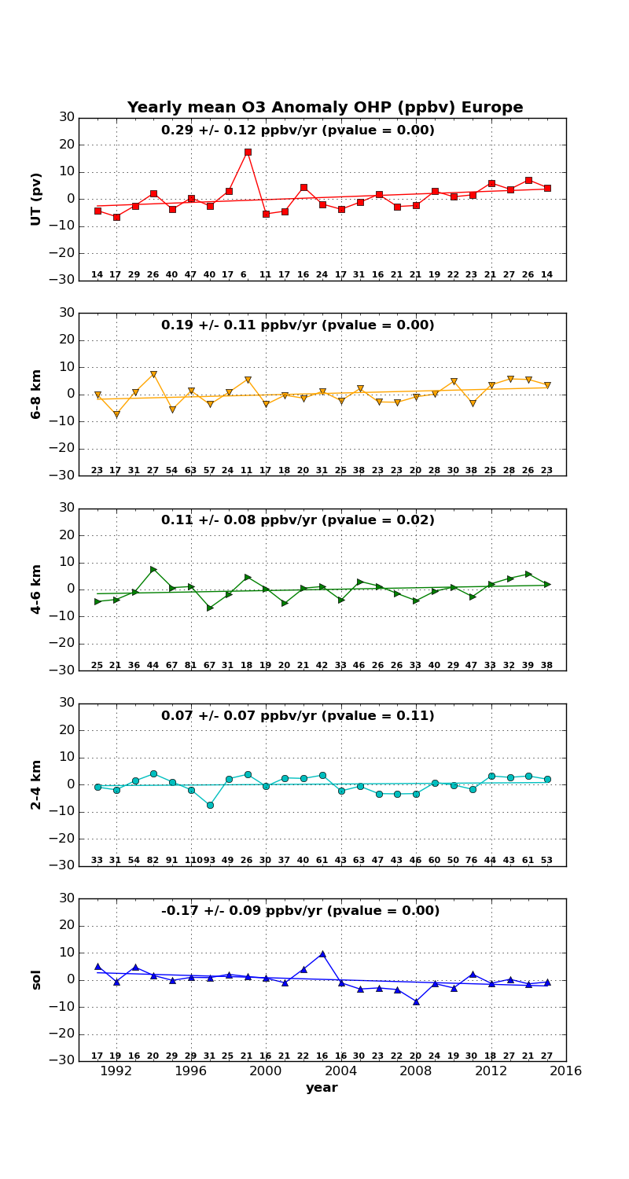
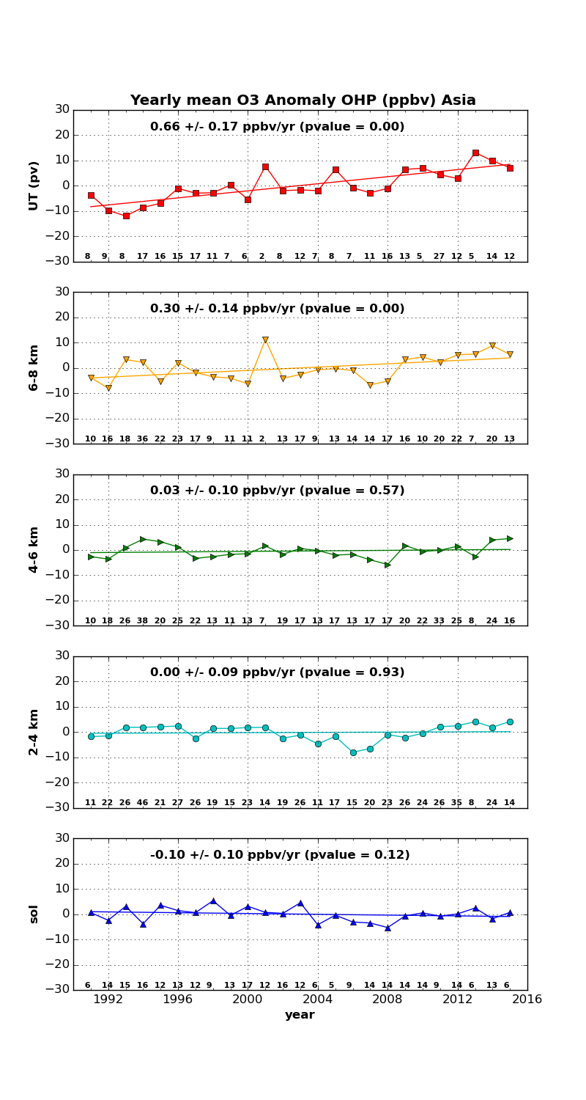
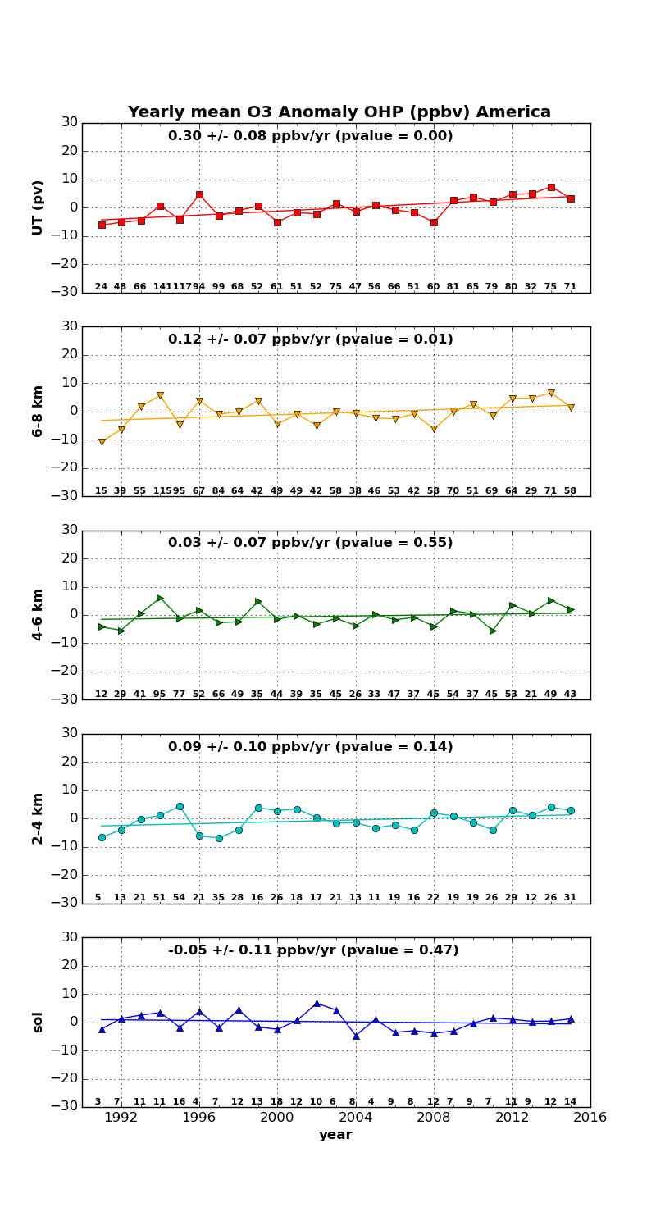
Tropospheric ozone trends
NDACC Lidar Working Group Huntsville May 2018

Slide 9
Issues for lidar operation at OHP
Strong human resources issues for lidar operation at OHP in the next years:
5 operators up to 2017
In 2018 departure of 2 operators
In 2019 – 2020 departure of station chief
Discussions with CNRS to get a new technician position
The position will have to be shared with other atmospheric observation services (ICOS, AERONET)
Automatization of lidar operation is being performed but it will need refurbishment of LiO3s and LTA telescopes
NDACC-FR involved in European ACTRIS Research Infrastructure project
Requires proposition of services for O3 lidar community
Proposal under discussion
NDACC Lidar Working Group Huntsville May 2018

